Slide 1
Optimizing Application Deployment with Blue-Green and Canary Releases on Kubernetes
Rolling out new features or updates can be risky, especially in production environments. Blue-Green and Canary releases are deployment strategies that reduce the risk by enabling phased rollouts and quick rollbacks if issues arise.

Slide 2
Project Goals
Implement Blue-Green and Canary deployment strategies using Kubernetes.
Automate the process of switching between environments to minimize downtime.
Monitor and analyze the impact of new releases to ensure stability before full rollout.
Establish rollback mechanisms to revert changes quickly in case of issues.

Slide 3
Tools Used
Kubernetes for container orchestration
Argo Rollouts or Flagger for advanced deployment strategies
Helm for Kubernetes package management
Prometheus and Grafana for monitoring and performance analysis
Istio or Linkerd for service mesh and traffic management
Jenkins or GitLab CI/CD for pipeline automation

Slide 4
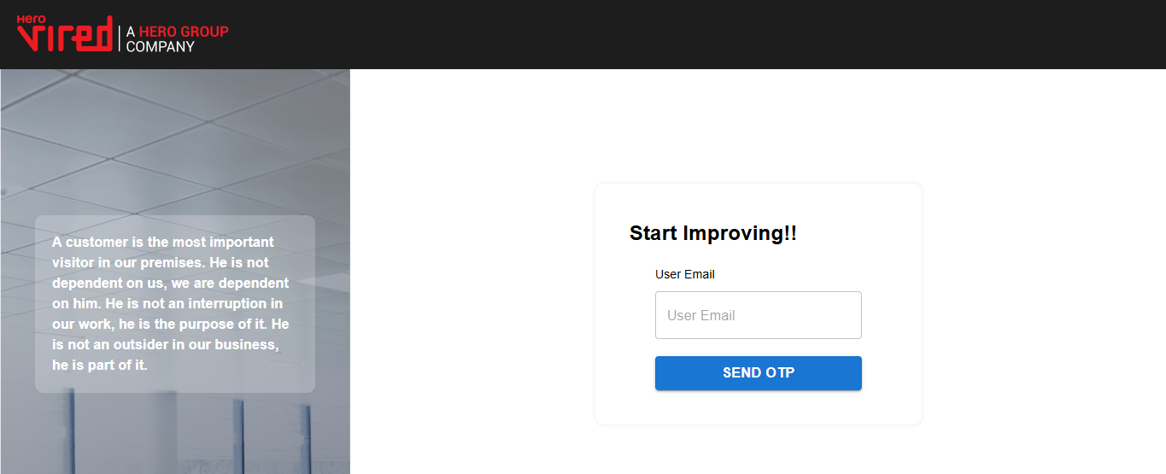
Project Name: NPS Project Source: https://github.com/UnpredictablePrashant/NPS.git

Slide 5
Kubernetes
Kubernetes is an open-source platform for managing containerized applications. It automates the deployment, scaling, and management of containerized applications, making it easier for developers to build, deploy, and scale their applications.
Benefits of Using Kubernetes:
Increased Efficiency: Kubernetes automates many manual tasks, making it easier to manage and deploy applications.
Improved Scalability: It can easily scale applications up or down to meet changing demands.
Portability: Kubernetes applications can be easily moved between different environments, such as development, testing, and production.
Reliability: Kubernetes' self-healing capabilities ensure that applications remain available even in the face of failures.

Slide 6
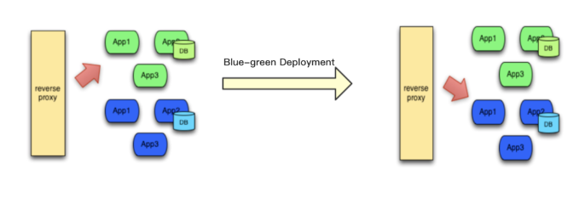
Blue-Green Deployment with Kubernetes
Blue-Green deployment is a deployment strategy that minimizes downtime by maintaining two production environments: a blue environment and a green environment. Only one environment is active at a time, while the other is used for testing or staging.

Slide 7
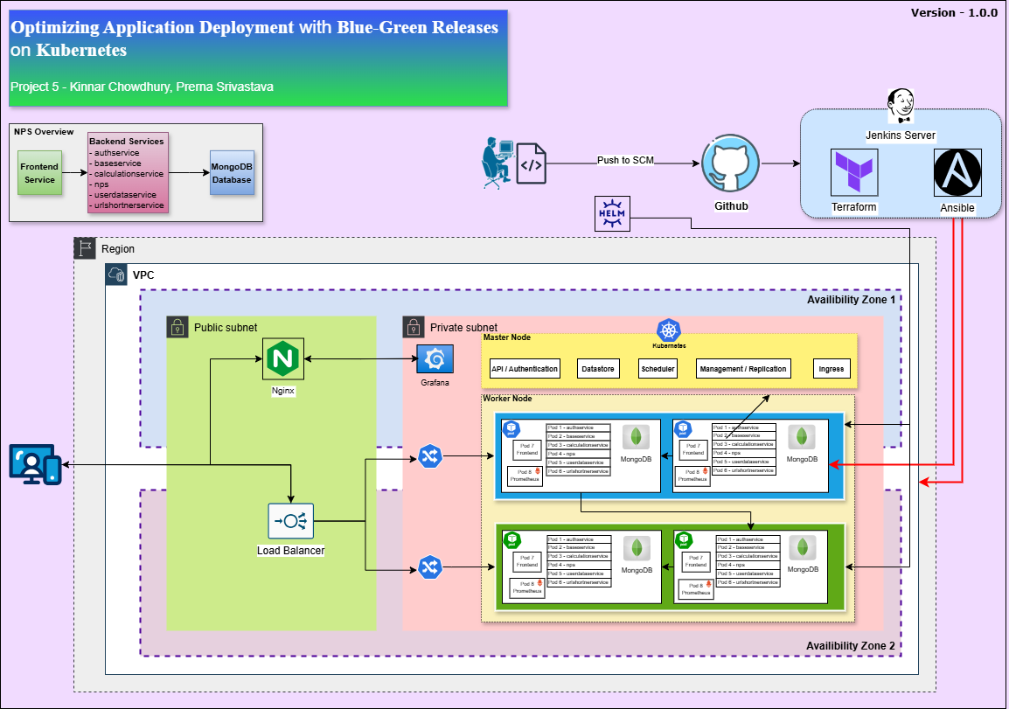
Architecture Diagram of Blue-Green Deployment

Slide 8
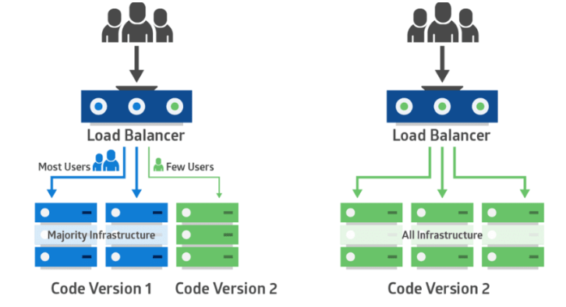
Canary Deployment with Kubernetes
Canary deployment is a progressive delivery strategy where a small subset of users (the canary group) are exposed to a new version of an application before it's fully rolled out to the entire user base. This approach allows for gradual deployment, risk mitigation, and easier rollback if issues are discovered.

Slide 9
Thank You

